Slide 1



Interest Rate Analysis (Financial Sector) In India
India's financial sector is dynamic and complex, with interest rates playing a crucial role in shaping economic activity. This presentation explores the key interest rate indicators, their trends, and their impact on the financial sector.

Slide 2
Interest Rate Indicators
91/364 Days T-bills
Repo Rate
Bank Rate, PLR, and MCLR
Treasury bills are short-term debt instruments issued by the government to raise funds. These instruments are highly liquid and considered safe-haven assets.
The repo rate is the rate at which the Reserve Bank of India (RBI) lends money to banks against government securities. It is a key tool used by the RBI to control liquidity in the financial system.
The bank rate is the rate at which the RBI lends to banks for longer periods. The Prime Lending Rate (PLR) and Marginal Cost of Funds based Lending Rate (MCLR) are rates used by banks to lend to customers.

Slide 3


Turnover in Government Securities
1
Government Bond Market
2
Secondary Market Liquidity
The government bond market is a key segment of India's financial sector, providing a platform for the government to borrow funds and for investors to invest in low-risk assets.
The secondary market for government securities is crucial for providing liquidity and ensuring that the government can raise funds efficiently.
3
Foreign Investment
4
Monetary Policy Impact
Foreign investors play a significant role in the government bond market, contributing to its size and liquidity.
The RBI's monetary policy decisions, such as changes in the repo rate, can influence the turnover in the government securities market.

Slide 4


Market Borrowing of Central Government
Year
Market Borrowing (in INR Billion)
2020-21
11,000
2021-22
12,000
2022-23
13,000

Slide 5


Call Money Rates
1
Overnight Lending
Banks lend to each other overnight to meet short-term liquidity needs.
2
Interbank Market
Call money rates are determined in the interbank market, where banks borrow and lend funds for very short periods.
3
RBI's Role
The RBI plays a role in managing liquidity in the interbank market by injecting or withdrawing funds.

Slide 6
Liquidity Adjustment Facility (LAF)
Repo Rate
Reverse Repo Rate
Liquidity Management
The LAF is a tool used by the RBI to manage liquidity in the financial system by providing short-term funds to banks at the repo rate.
The RBI absorbs liquidity from the system by borrowing funds from banks at the reverse repo rate.
The LAF helps to ensure that the banking system has adequate liquidity to meet the needs of the economy.

Slide 7

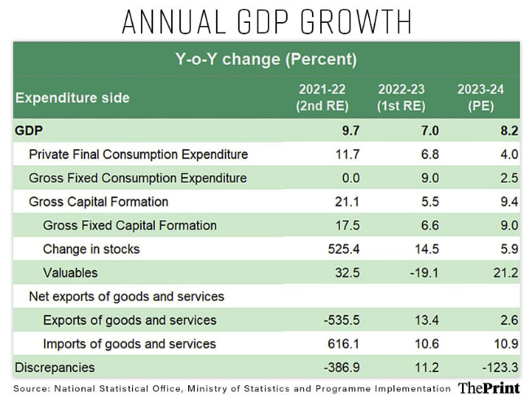



Factors Affecting Interest Rates
Inflation
High inflation often leads to higher interest rates as lenders demand a higher return to compensate for the erosion of their purchasing power.
Economic Growth
Strong economic growth can lead to higher interest rates as businesses demand more funds for expansion, increasing demand for credit.
Government Policies
The RBI's monetary policy decisions, including changes in the repo rate and LAF operations, significantly influence interest rates.

Slide 8
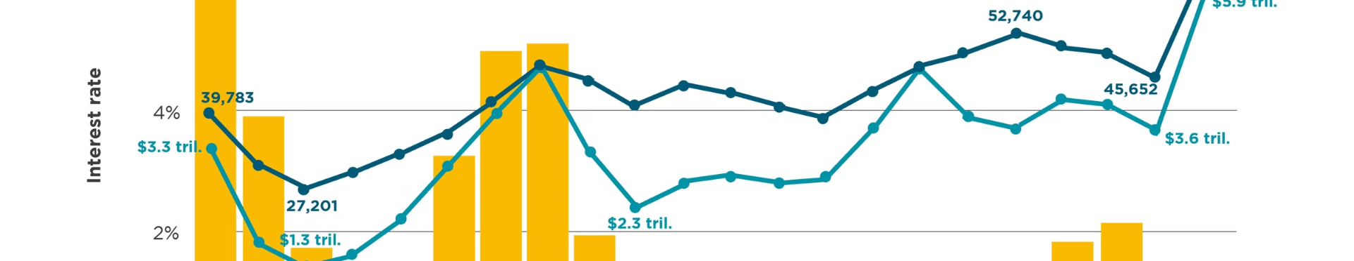



Trends in Interest Rates
Recent Trends
Impact of Global Factors
Future Outlook
Interest rates in India have been gradually declining in recent years, reflecting the RBI's efforts to stimulate economic growth.
Global interest rate trends and economic conditions also play a role in shaping interest rate movements in India.
Interest rates are expected to remain low in the near term, but their trajectory will depend on the evolving economic landscape.

Slide 9
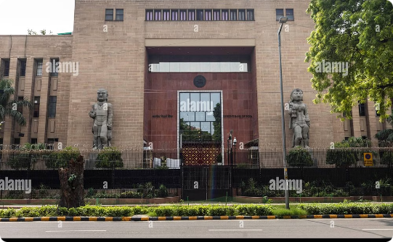
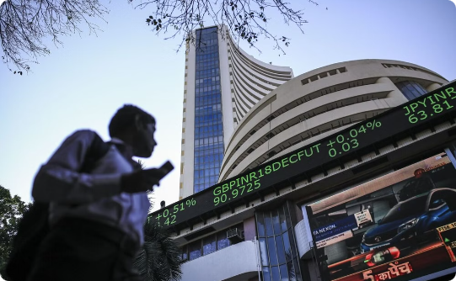

Impact of Interest Rates on the Financial Sector
Bank Lending
Equity Market
Real Estate
Lower interest rates encourage banks to lend more, leading to increased credit availability for businesses and consumers.
Interest rate changes can influence the attractiveness of equities compared to fixed-income investments, affecting the performance of the stock market.
Lower interest rates can make borrowing more affordable, stimulating demand for housing and other real estate investments.

Slide 10


Conclusion and Recommendations
Interest rates play a vital role in the Indian financial sector, influencing lending, borrowing, investment decisions, and overall economic activity. The RBI's skillful management of interest rates is crucial for fostering sustainable growth and ensuring financial stability.

Slide 11

MANAGERIAL ECONOMICS – BILL GATES
Mrunmayi Sunkale - 021330024508
Aagam Shah - 021330024003
Kalpesh Patil - 021330024018
Mubeen Khan - 021330024344
Pranav Wagh - 021330024162
Saigita Goklani - 021330024398
Aditi Singh - 021330024005
THE END

